Slide 1
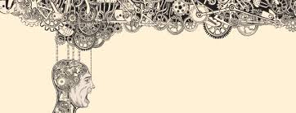
Psychology of Design

Slide 2
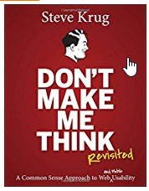
Don't Make Me Think, Revisited: A Common Sense Approach to Web Usability
(3rd Edition)
by Steve Krug

Slide 3
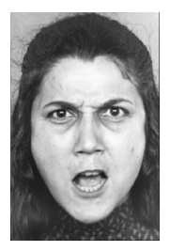
Notes:
You immediately saw that the woman’s hair is dark, that she is angry and that she is most likely about to say something. In fact, you cannot avoid having those impressions.

Slide 4
CAT
Notes:
Try to not read the word. It’s impossible.

Slide 5
17 x 24
Notes:
You saw immediately that this is a multiplication problem and had a rough idea of the range of possible results.
However, the precise solution did not come to mind. Do the calculation in your mind. It’s difficult to hold intermediate results in your mind while thinking about and performing the next step. It’s deliberate, effortful and orderly.
Not just your mind is working: your body tenses, you blood pressure rises, heart rate increases and your pupil dilate.

Slide 6
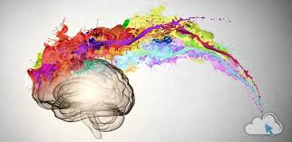
Two Systems

Slide 7
Two Systems
System 1 is automatic and quick with no effort and no sense of voluntary control
System 1 originates impressions and feelings that are the main source of the beliefs and deliberate choices of System 2
System 2 allocates attention to effortful mental activities that demand it. System 2 operations are associated with the subjective experience of agency, choice and concentration.
When we think of ourselves we identify with System 2, the conscious reasoning self that has beliefs, makes choices and decides what to think about and what we do.

Slide 8
System 1
Many functions of System 1 are ingrained at birth
Many others are learned through experience and/or prolonged practice
Some are shared by many but others are obtained by experts
Many functions of System 1 are involuntary while others (chewing gum) are subject to control but normally run on automatic pilot

Slide 9
System 1
System 1 is responsible for things like
Detecting that one object is more distant than another
Completing the phrase “bread and …”
Detecting hostility in a voice
Answering 2 + 2 = ?
Driving a car on an empty road
Understanding simple sentences
Making a disgust face when shown a horrible picture

Slide 10
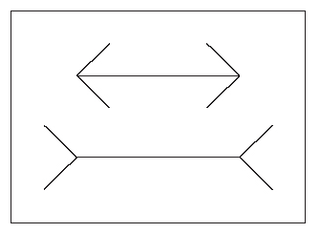
Cognitive Illusions
Notes:
You probably have seen this illusion before so you know that the lines are the same length but you cannot avoid the immediate impression that the lower line is longer because system 1 in incapable of seeing the lines that way.

Slide 11
Associative Machine of System 1
System 1 operates through a process of associative activation: ideas that are evoked trigger many other ideas through an associative network in memory
You have no control over this process
The key feature of the process is coherence, System 1 tries to make sense of inputs regardless of what they are.
System 1’s response to inputs are an attenuated replica of the real thing explaining your physical response to the words

Slide 12
System 2
System 2 is responsible for effortful cognitive processing
One of its main functions is to monitor and control thoughts and actions suggested by System 1 allowing some to be expressed in behavior and suppressing or modifying others
System 2 is responsible for deliberate searches of memory and directing problem solving efforts
System 2 uses an enormous amount of energy and becomes less effective when that energy (blood glucose) is depleted
Notes:
Chocolate cake vs fruit experiment
Willpower as an exhaustible resource

Slide 13
Invoking System 2
There is a two way connection between System 2 and your body
When System 2 is invoked your pupils dilate, your heart rate increases, your blood pressure rises, you frown
You can invoke System 2 by frowning or suppress System 2 by smiling or blowing your cheeks out
While walking with a friend ask them to multiply 17 and 63
Notes:
They’ll stop walking

Slide 14
Add 3 to each digit
5284
2842
D
Notes:
Start beating a rhythm. Show the numbers and read the four digits aloud. Wait for two beats, then report a string in which each of the original digits is incremented by 3.
This maxes out system 2

Slide 15
System 2
In normal operation, System 2 accepts System 1’s suggestions with little or no modification (System 2 is lazy)
People find cognitive effort at least mildly unpleasant and avoid it as much as possible.
People are often overconfident, prone to place too much faith in their intuitions.

Slide 16
System 1 and System 2 Together
Both System 1 and System 2 are continuously active
System 1 runs automatically and System 2 is normally in a low-effort mode
System 1 continuously generates suggestions for System 2: impressions, intuitions, intentions and feelings
If endorsed by System 2, impressions and intuitions become beliefs and impulses turn into voluntary actions
System 2 becomes activated when an event occurs which violates System 1’s model of the world, when it detects an error is about to be made, danger is sensed, etc.

Slide 17

Cognitive Ease

Slide 18
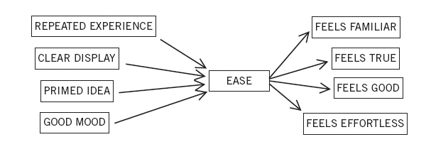
Cognitive Ease
When you are in a state of cognitive ease, you are probably in a good mood, like what you see, believe what you hear, trust your intuitions, feel the current situation is familiar and System 2 is taking the day off
When you are in a state of cognitive strain you are more like to be vigilant, suspicious, invest more time in what you are doing, feel less comfortable and make fewer errors, are less intuitive and less creative
People are more likely to believe or recognize something when they are in a state of cognitive ease

Slide 19
Cognitive Ease
When in a state of cognitive ease, System 1 produces a feeling of familiarity and System 2 relies on that impression for not getting involved
The downside of this is that anything that makes it easier for System 1 to run smoothly will also bias beliefs
For example, a reliable way to make people believe in falsehoods is frequent repetition, because familiarity is not easily distinguished from truth
Notes:
If you see a random name and a few days later see the name in a list of other names you will think that it is a celebrity because it’s name you are familiar with
Repeated phrases are more easily believed, a fact used by marketers, politicians and dictators. It doesn’t even have to be the entire phrase
Exposure to “the body temperature of a chicken” makes people more likely to believe “the body temperature of a chicken is 144”
Turkish words in a student newspaper. Which ones mean something good and which ones are bad. Familiarity evokes ease and pleasure

Slide 20

How People Do Things

Slide 21
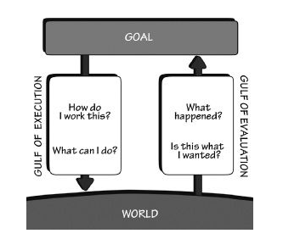
How People Do Things
When people use technology they have to figure out how to make it do what they want (Gulf of Execution) and what happened when the take some action (Gulf of Evaluation)
Good design is about making these two gulfs small

Slide 22
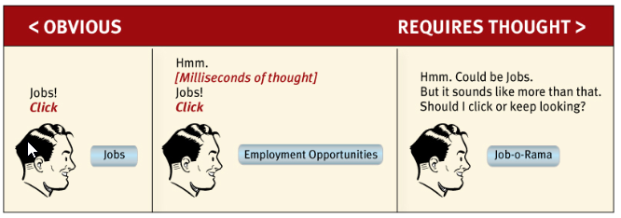
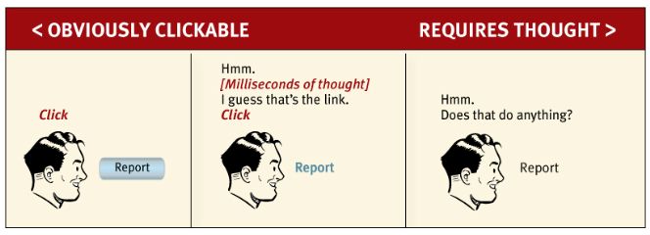

Slide 23
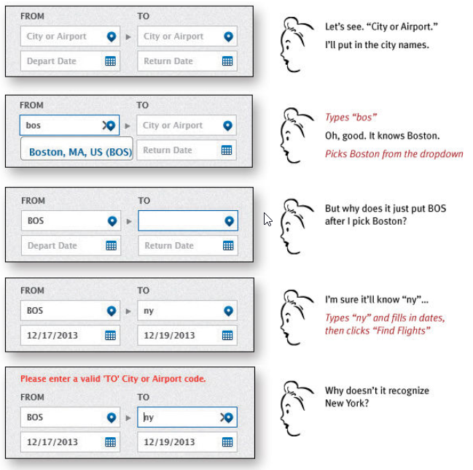

Slide 24
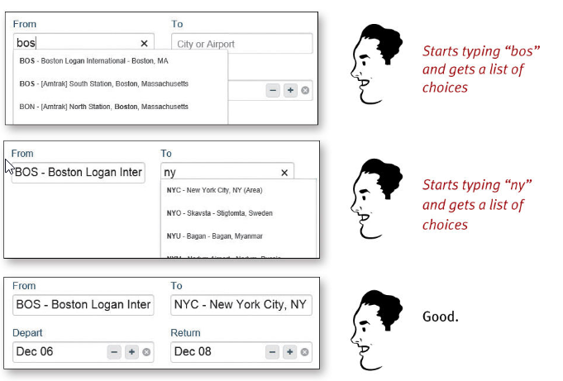

Slide 25
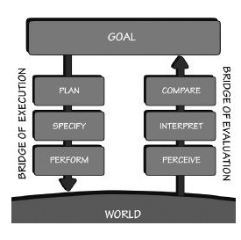
Seven Stages of Action

Slide 26
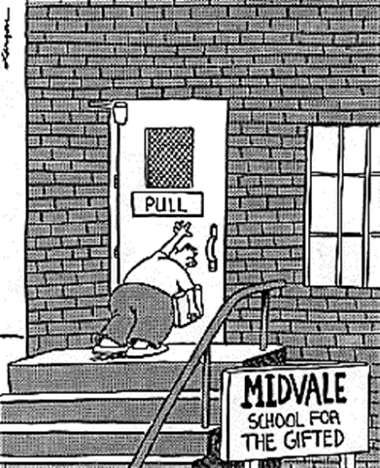
Bridging the Gulf of Execution
Affordances
Affordances are a relationship between the properties of an object or app and the capabilities of a person that determine how the object or app can be used.
A chair affords support and therefore affords sitting, Most chairs can be carried so they afford lifting
Affordances represent the possibilities
If an app or object prevents some action then it’s an anti-affordance
Signifiers
Affordances and anti-affordances become discoverable through signifiers
For example, how do users know what links are clickable or that they can scroll through screens by swiping
Examples of signifiers
How do you know whether the train will arrive soon when you enter a subway station
How do you know which way the wind is blowing
How to react in a social situation
Signifiers can be deliberately designed or rely on convention (e.g. a Submit button on a web page)
Notes:
An affordance is defined by the relationship between the person and the app or object and is not an inherent property of the app or object. For example, the affordances of an app for a person who is visually impaired are different than for other people.

Slide 27
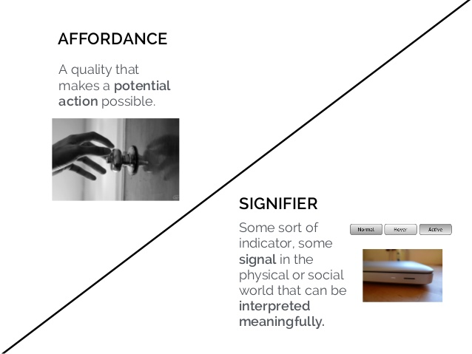

Slide 28
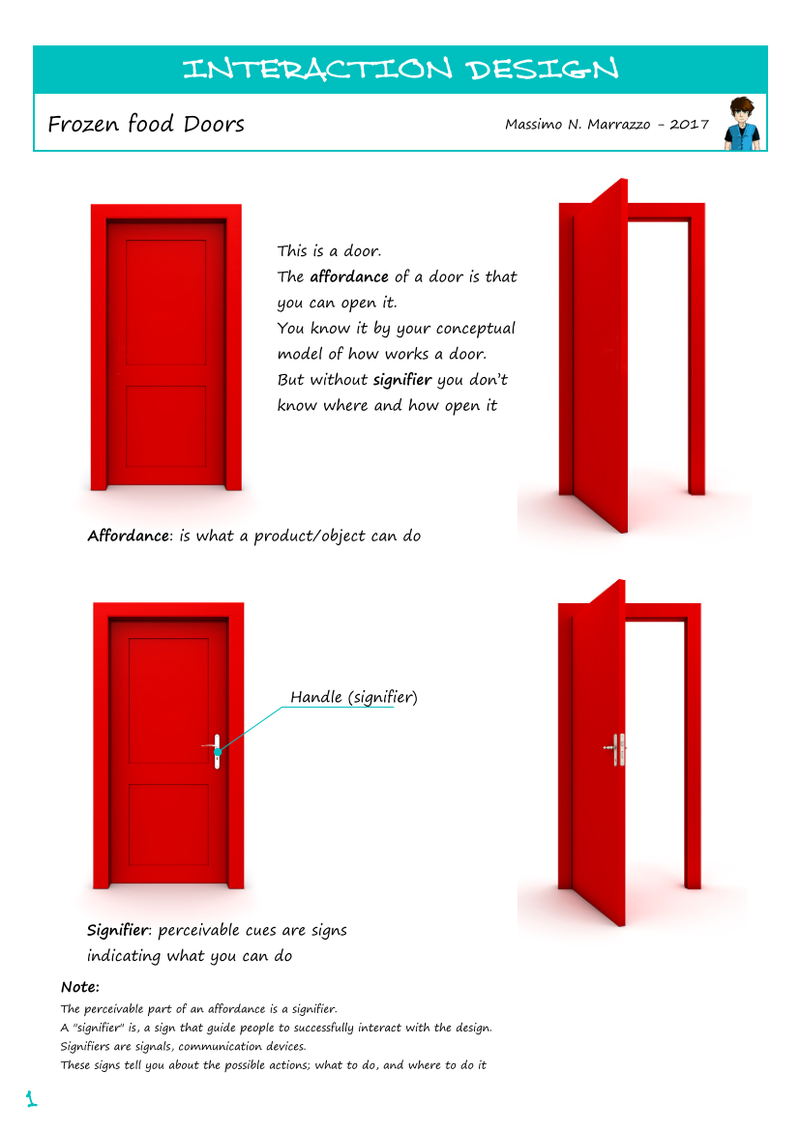

Slide 29
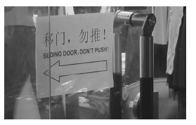
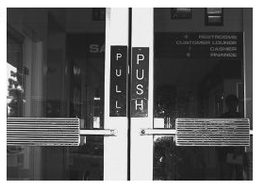
Signifiers

Slide 30
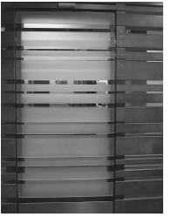
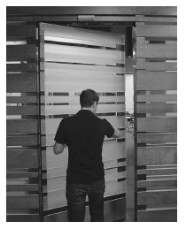
Signifiers?

Slide 31
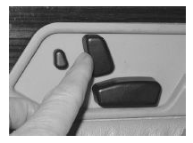
Bridging the Gulf of Execution
Mappings
Mappings is the relationship between two sets of things (e.g. the mapping between a set of switches and the lights in a room)
If a mapping uses spatial correspondence between the layout of controls and devices being controlled, it’s easy to determine how to use them (e.g. steering wheel in a car)
Mapping should allow a user to be able to construct a coherent mental model of how the controls work
Natural mappings, taking advantage of spatial analogies, lead to immediate understanding
Things like grouping, proximity and colors can be used to create mappings in user interfaces
Constraints
Constraints limit how something can be used
Physical - e.g. the shape of a USB drive
Cultural – e.g. Red lights go on the top
Semantic – Semantics is the study of meaning. Semantic constraints rely on the meaning of a situation to control actions. e.g. Red text is used to indicate errors.
Logical – e.g. natural mappings rely on logical constraints
Natural mapping for seat controls

Slide 32
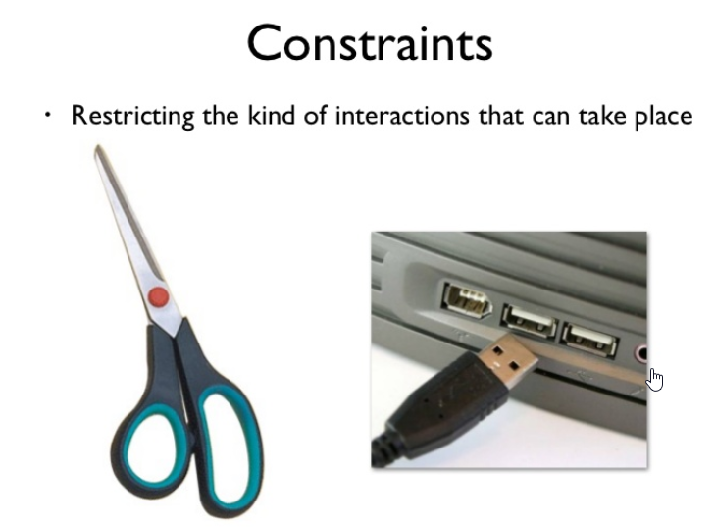

Slide 33
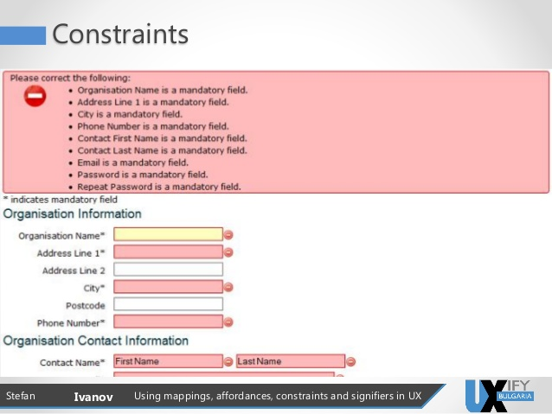

Slide 34

Shrinking the Gulf of Evaluation
Feedback
Communicating the results of an action
Feedback should be:
Immediate
Informative
Unobtrusive but not annoying
Parsimonious
A good conceptual model
An explanation for how something works
e.g. Files and folders are useful conceptual models for how electronic files are stored
Clues to how things work are gleaned from affordances, signifiers, constraints and mappings
It’s easy to develop a conceptual model of scissors
Good conceptual models allow the user to predict how an app or object will behave
Conceptual models that work in one circumstance can become a hindrance in another

Slide 35
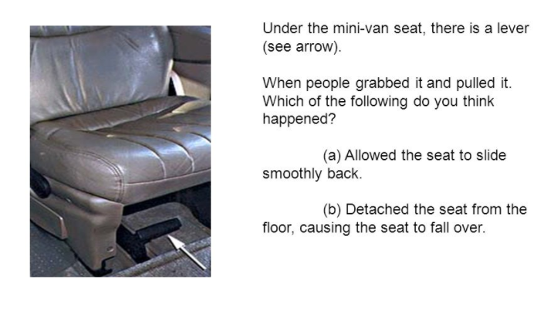

Slide 36
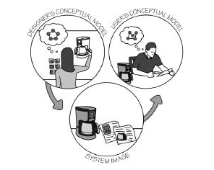
Conceptual Models
The goal of the designer is to conceive of a coherent model of how an app works then use signifiers, constraints and mappings to allow the user to develop the same conceptual model

Slide 37
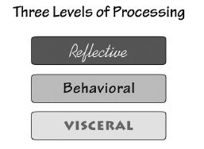
Emotions
Cognition and emotion are inseparable
Cognition attempts to make sense of the world – emotion assigns value
People are unable to turn off System 1 which is the primary source of emotions so it’s impossible to design without appealing to emotional responses
Because people respond more positively when at cognitive ease, a design which reinforces that state will be more appealing and likely more functionally appropriate

Slide 38
Principles of Design
Affordances
The proper affordance exist to make he desired actions possible.
Signifiers
Effective use of signifiers ensures discoverability and that the feedback is well communicated and intelligible.
Mappings
The relationship between controls and their actions follows the principles of good mapping, enhanced as much as possible through spatial layout and temporal contiguity
Constraints
Providing physical, logical, semantic and cultural constraints guide actions and eases interpretation
Discoverability
Is it possible to determine what actions are possible and the current state of the application
Feedback
There is full and continuous information about the results of actions and the current state of the application
Conceptual model
The app projects all the information required to create a coherent conceptual model of the system, leading to understanding and a feel of control. The conceptual model enhances both discoverability and evaluation of results.

Slide 39
References
Don't Make Me Think, by Steve Krug
Thinking Fast and Slow, by Daniel Kahneman

